Slide 1
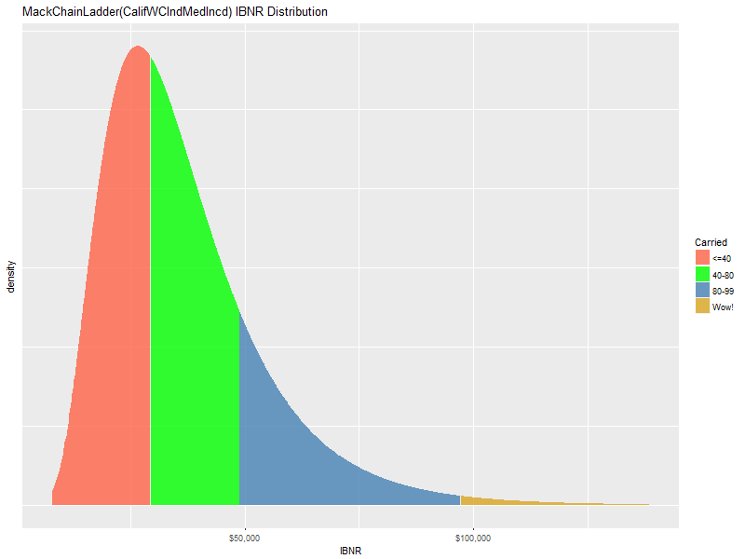
Mack/Murphy Unchained
CLRS 2018 Anaheim CA Daniel Murphy Trinostics

Slide 2

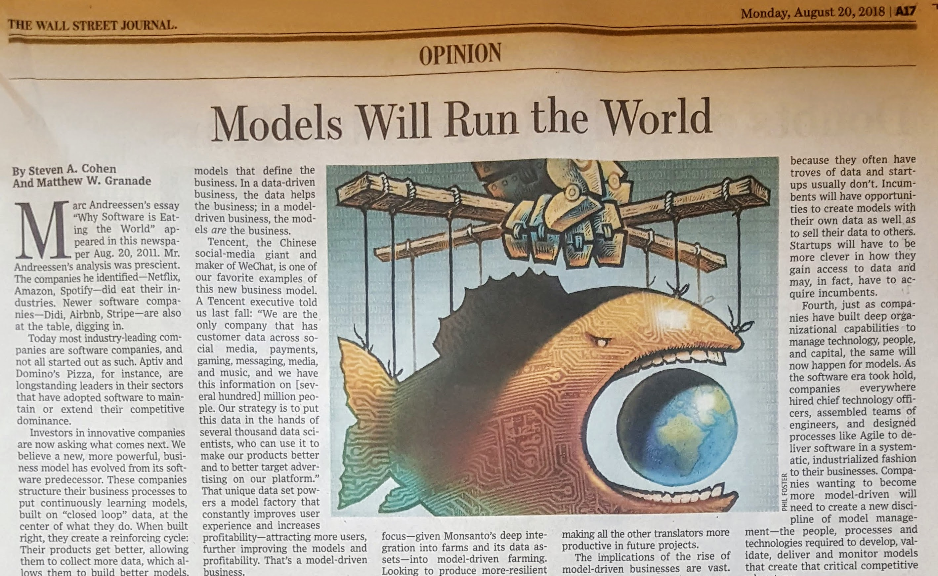
Strats
In a model-driven business, the models are the business
Notes:
Steven Cohen, Matthew Granade, Point72 LP

Slide 3
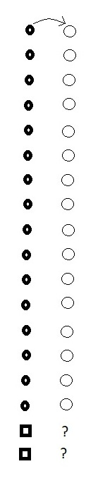
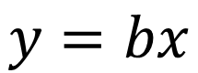
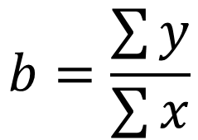
Chain-Ladder First Link: The Method
method
$$y=bx$$
We observe some objects that have changed over time (the circles)
We observe two new objects (the squares)
What is an estimate of their changed values?
traditional average link ratio
$$b=\frac{\sum{y}}{\sum{x}}$$

Slide 4
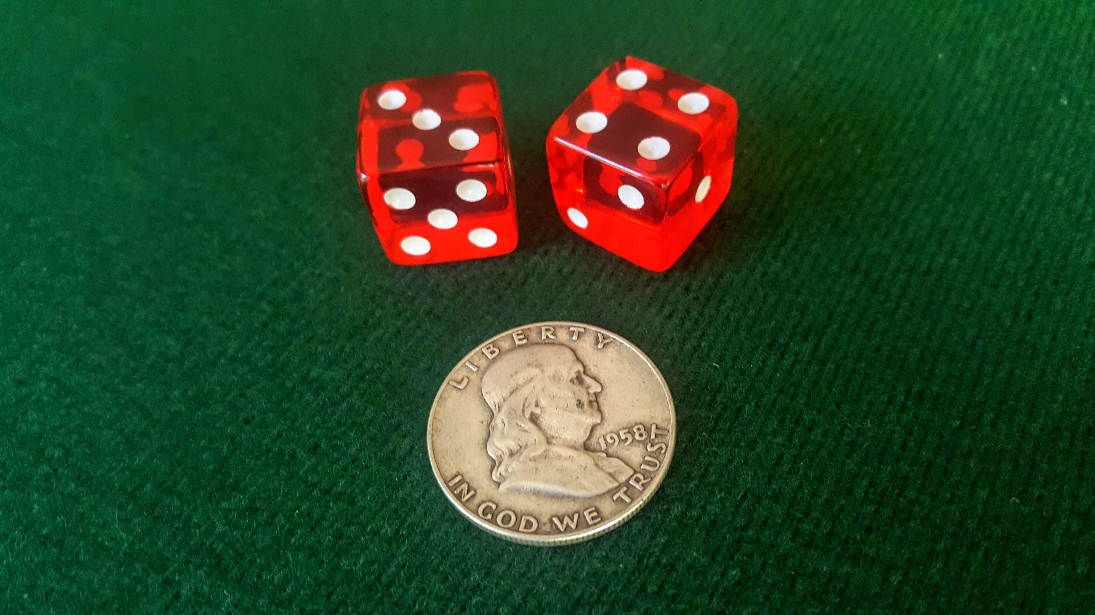
Let’s play a game
* biased coin idea thanks to https://izbicki.me/blog/how-to-create-an-unfair-coin-and-prove-it-with-math.html

Slide 5
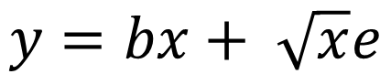
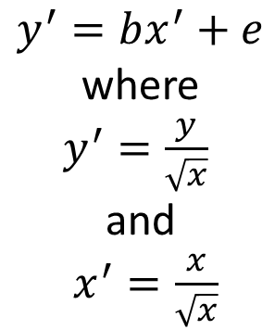
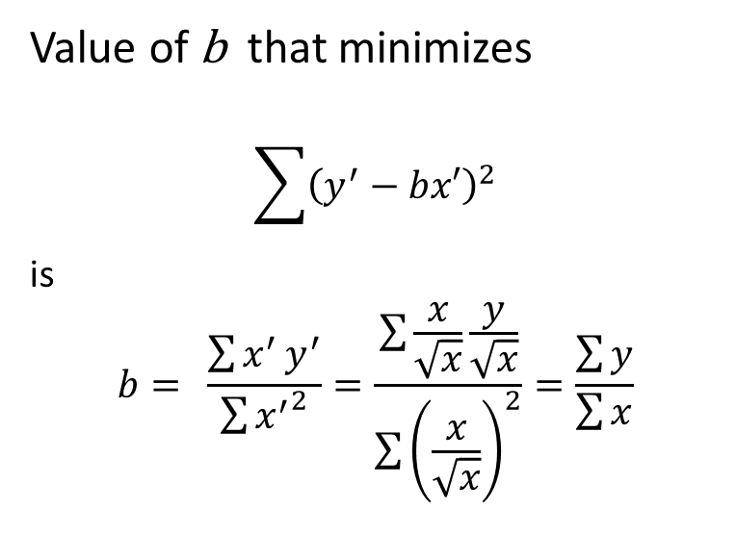
Chain-Ladder First Link: The Model
error term makes it a model
$$y=bx+ \sqrt{x}e$$
equivalent model
Value of b that minimizes
$$\sum{{\left(y^{′}−bx′\right)}^{2}}$$
is $$b= \frac{\sum{x^{′}}y^{′}}{\sum{{x^{′}}^{2}}}=\frac{\sum{\frac{x}{\sqrt{x}}\frac{y}{\sqrt{x}}}}{\sum{{\left(\frac{x}{\sqrt{x}}\right)}^{2}}}=\frac{\sum{y}}{\sum{x}}$$
Calculus
$$y^{′}=bx^{′}+e$$
where
$y^{′}=\frac{y}{\sqrt{x}}$
and
$x^{′}=\frac{x}{\sqrt{x}}$

Slide 6
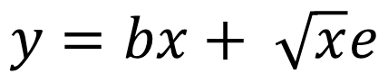
Chain-Ladder First Link: An Example
Apply the model to this skinny triangle
$$y=bx+ \sqrt{x}e$$

Slide 7
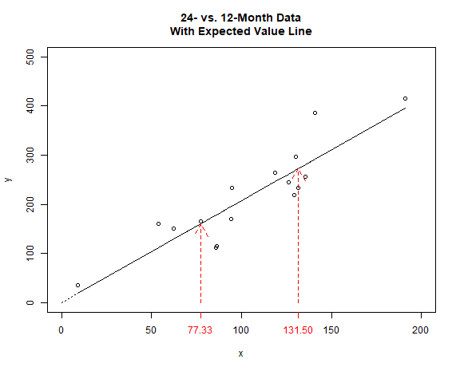
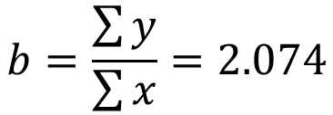
12-24 Month Development Experience
$$b=\frac{\sum{y}}{\sum{x}}=2.074$$
2.074 = slope of the line through origin
prediction of new initial observations: 77.33 -> 160.4 131.5 -> 272.7

Slide 8
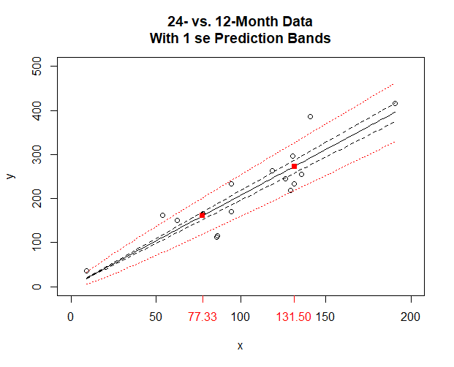
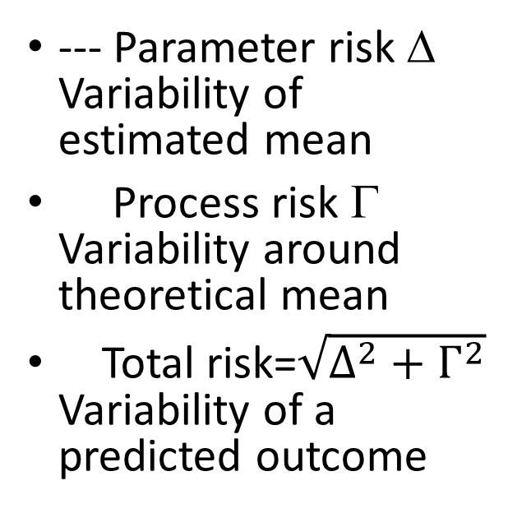
Predictions are not certain: prediction bands
--- Parameter risk Δ Variability of estimated mean
Process risk Γ Variability around theoretical mean
Total risk=$\sqrt{Δ^{2}+Γ^{2}}$ Variability of a predicted outcome
* notation by Ali Majidi
Notes:
Notation by Ali Majidi

Slide 9

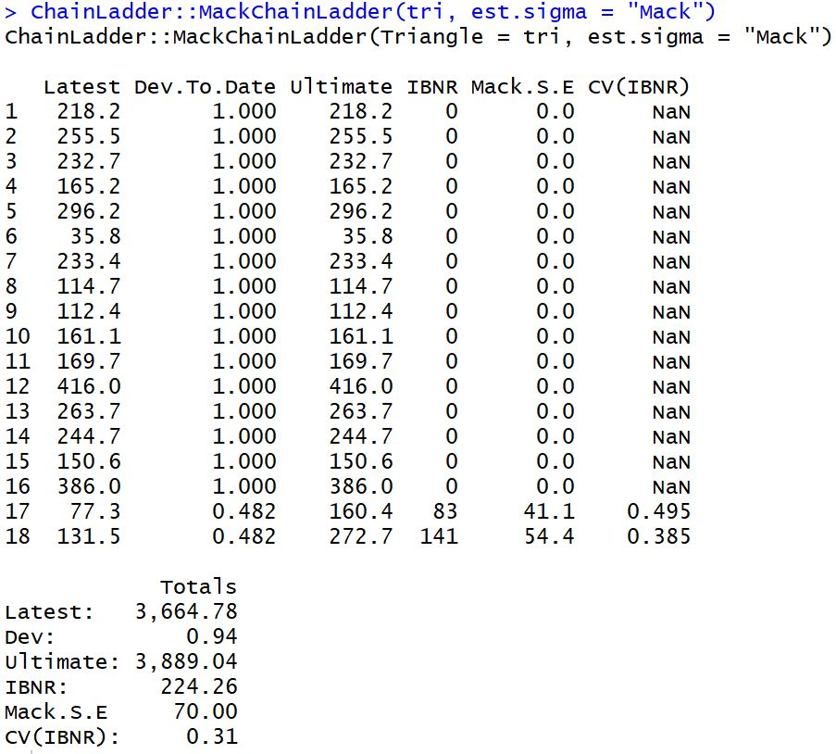

Predictions are not certain: prediction bands
With
} 54.4
} 41.1
* ChainLadder package by Markus Gesmann et.al.

Slide 10
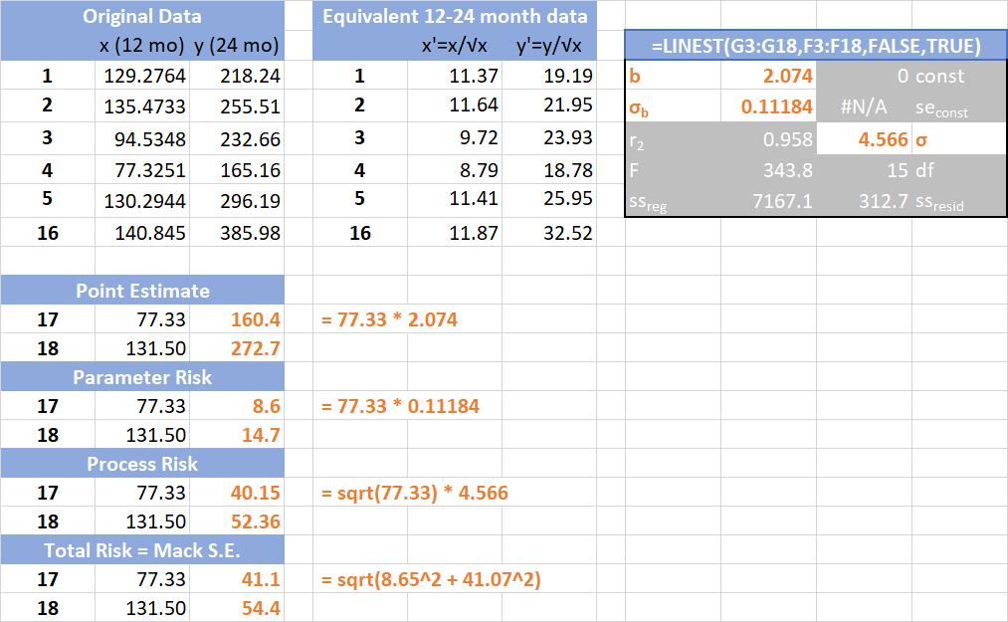

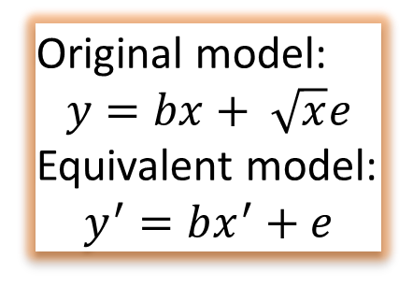
Predictions are not certain: prediction bands
With
Original model:
$$y=bx+ \sqrt{x}e$$
Equivalent model:
$$y^{′}=bx^{′}+e$$
Statistics from equivalent model’s data …
… applied to original model’s data

Slide 11
Why does the prediction envelope fan out only at the high end?

Slide 12
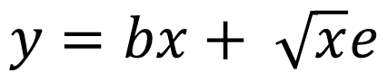
Chain-Ladder link
hint
$$y=bx+ \sqrt{x}e$$
Assumption is, The higher the initial value, the greater the variability of the subsequent value
When might you have less variability the larger the beginning value?

Slide 13
How do prediction bands look under different models?

Slide 14
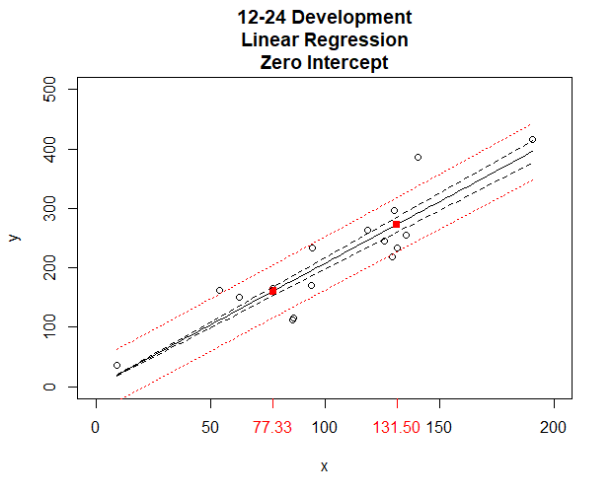
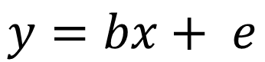
Prediction bands without square-root-o-skedasticity
$$y=bx+ e$$
--- parameter risk
total risk
Notes:
image Dev12-24LinRegZeroIntercept.png
script WithIntercept MoreDisperse.R

Slide 15
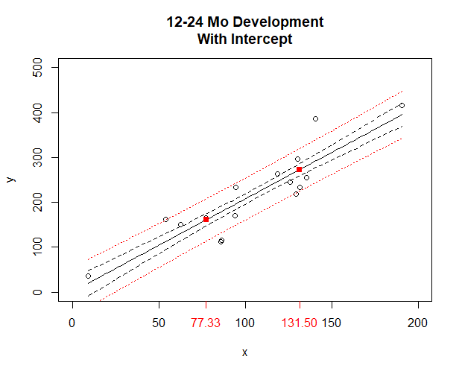
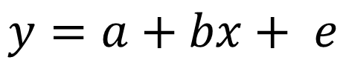
Prediction bands when there’s an intercept
$$y=a+bx+ e$$
--- parameter risk
total risk

Slide 16
Homework
What would the graph of the model look like if the simple average is the optimal link ratio?
Does the answer change if “optimal” is a matter of actuarial judgment?
What could be drivers of a non-zero intercept?
How to model the BF method within the Chain-Ladder paradigm?
How to model the first column within the Chain-Ladder paradigm?

Slide 17
Chain-Ladder Second Link: Add Another Column

Slide 18
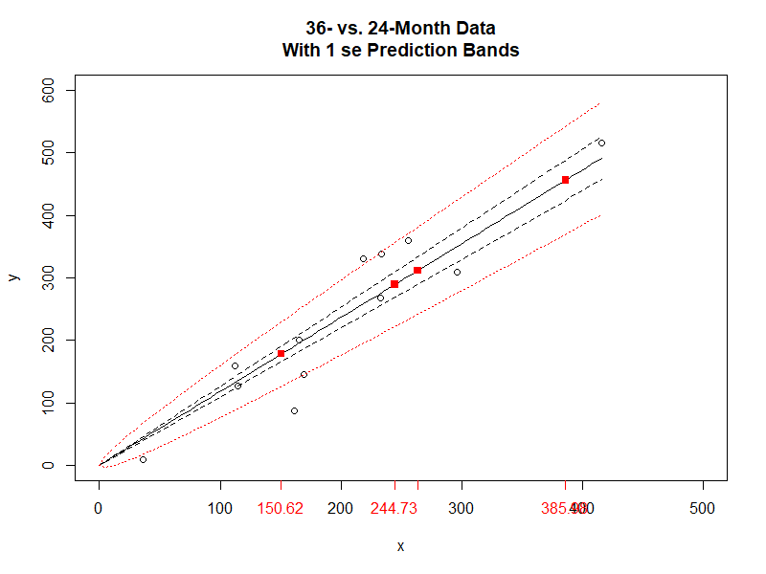
Chain-Ladder Second Link: Add Another Column
b_{y} = 1.181
sigma_b_{y} = 0.083
sigma_{y} = 4.1

Slide 19
Chain-Ladder predicts the future recursively
Orange projections are products of a scalar and an estimated parameter
Which is which?
Formulas for Parameter Risk and Process Risk are above
Red projections are products of an estimate and an estimated parameter
Formulas for Parameter Risk and Process Risk are derived from the Law of Total Variance

Slide 20
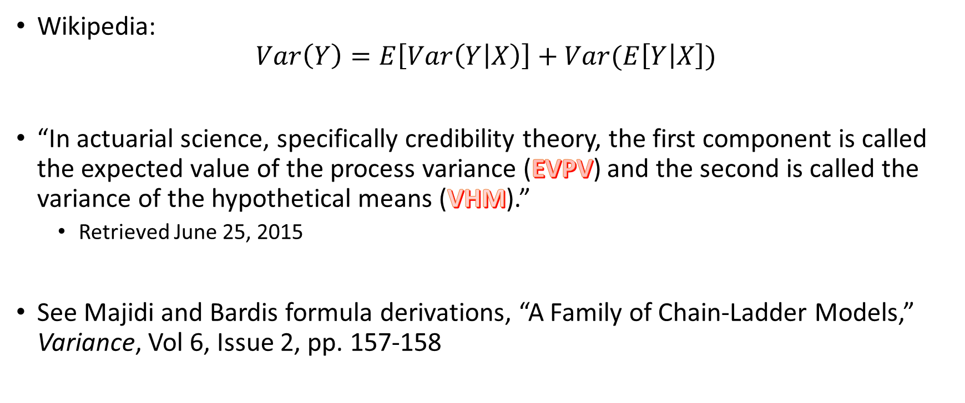
Law of Total Variance
sidebar
Wikipedia: $Var\left(Y\right)=E\left[Var\left(Y | X\right)\right]+Var(E\left[Y | X\right])$
“In actuarial science, specifically credibility theory, the first component is called the expected value of the process variance (EVPV) and the second is called the variance of the hypothetical means (VHM).”
Retrieved June 25, 2015
See Majidi and Bardis formula derivations, “A Family of Chain-Ladder Models,” Variance, Vol 6, Issue 2, pp. 157-158
We finally made it! We’re in Wikipedia!

Slide 21
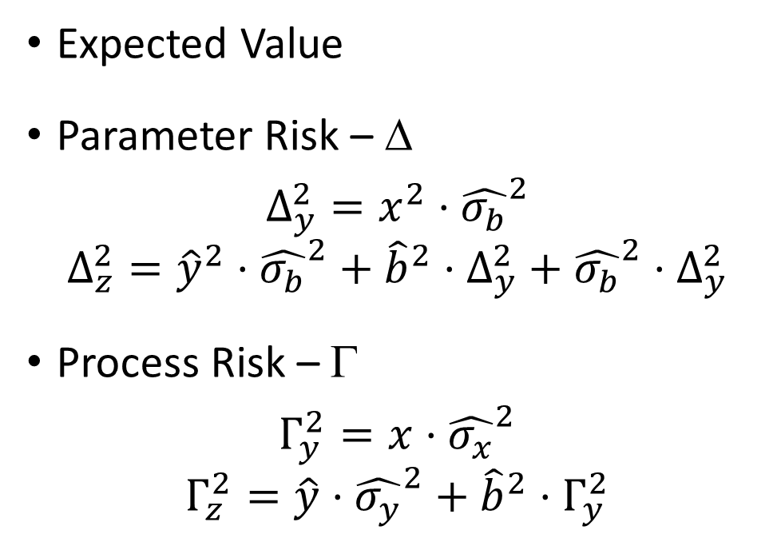
Recursive projections with statistics – complete many squares
Expected Value
Parameter Risk – Δ
$$Δ_{y}^{2}=x^{2}⋅{\hat{σ_{b}}}^{2}$$
$$Δ_{z}^{2}={\hat{y}}^{2}⋅{\hat{σ_{b}}}^{2}+{\hat{b}}^{2}⋅Δ_{y}^{2}+{\hat{σ_{b}}}^{2}⋅Δ_{y}^{2}$$
Process Risk – Γ
$$Γ_{y}^{2}=x⋅{\hat{σ_{x}}}^{2}$$
$$Γ_{z}^{2}=\hat{y}⋅{\hat{σ_{y}}}^{2}+{\hat{b}}^{2}{⋅Γ}_{y}^{2}$$
Don’t forget to transform the data before LINEST
Notes:
Save all the statistics and intermediate steps

Slide 22
Tricks for Risk Estimates for the Total/sum Row

Slide 23
Why not directly estimate the 12-36 month link ratio?
What if you learned b_{xz} = sum(z) / sum(x) = 2.337
Why not say the expected 36-month value of x = 77.33 is 77.33 * 2.337 = 157.5 rather than
77.33 * 2.074 * 1.181 = 189.4

Slide 24
Continue Chaining to Ultimate: Rinse and Repeat
Recursive estimates are carried forward to the last pair of development columns
Technical considerations
What to do when there are not enough observations to get a good estimate of sigma (zero degrees of freedom)
What to do with a tail
Mack has recommendations for handling these technicalities
The ChainLadder package’s MackChainLadder function includes Mack’s recommendations, as well as others
Let’s see some examples

Slide 25
California WCIRB Agenda June 2018 Combined Indemnity and Medical Incurred
* triangle creation approach thanks to Dave Bellusci
Notes:
Thanks to Dave Bellusci

Slide 26


MackChainLadder(WCIRB Indemnity + Medical Combined Incurred, tail = 1.025)

Slide 27
Reported industry IBNR @ 3/31/2018 = $36,196
~58%-ile Very close to MackChainLadder central estimate = $36,713

Slide 28
ChainLadder sample GL triangle ‘GenIns’ (in thousands)
GenIns is a triangle first published in Taylor & Ashe paper (1983) and repeatedly studied in the literature
Notes:
Taylor, G. and F. R. Ashe. 1983. Second Moments of Estimates of Outstanding Claims. Journal of Econometrics 23, 37-61.
Loss Reserving with GLMs: A Case Study Greg Taylor and Gr~inne McGuire
Greg’s more recent paper: http://www.variancejournal.org/articlespress/articles/Empirical-Taylor.pdf

Slide 29
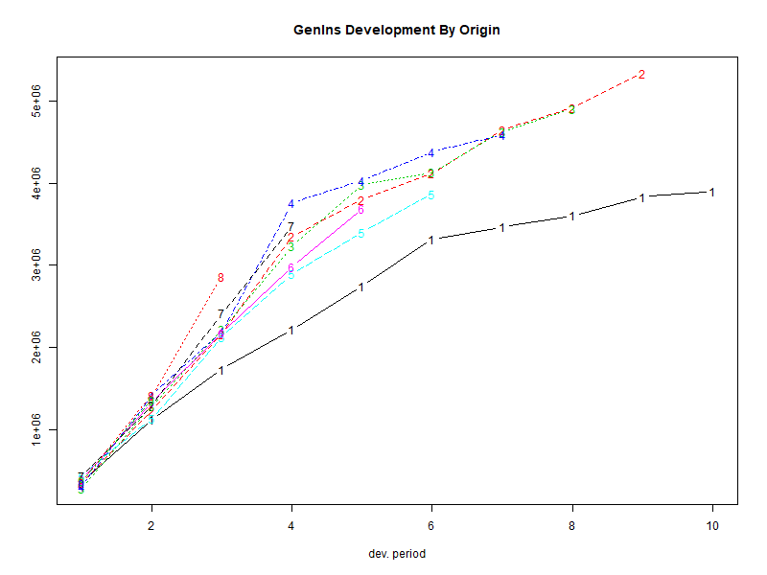
ChainLadder:: plot(GenIns)

Slide 30
MackChainLadder(GenIns)

Slide 31
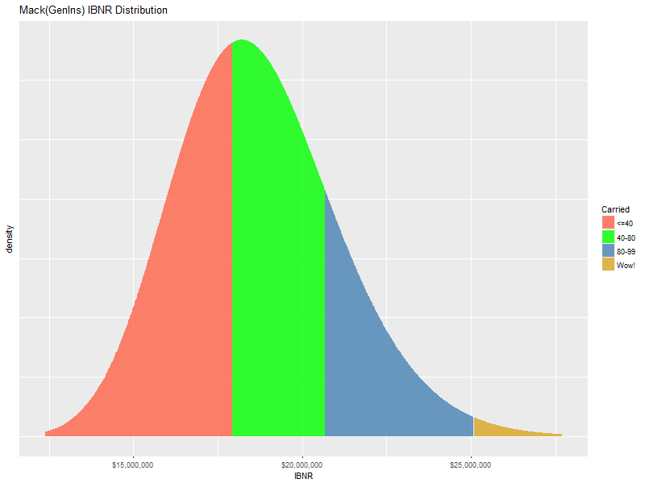
Safety Levels of GenIns Carried IBNR

Slide 32
What happens when Mack/Murphy is run on detail data?
Finally!
Suppose x and y are actually observations from 4 companies in 4 accident years
Will link ratios from aggregated data and detail data always be the same?
What about the risk statistics?

Slide 33
GenIns at the Claim Level
Hai You generated simulations of over 6000 synthetic claims whose accident year aggregation is “close in shape” to GenIns
We pegged the 13% cv as the primary measurement of similarity
Hai’s claim-characteristic choices included:
Frequency distribution
Severity distribution
Distribution for the number of payments per claim
Report lag and payment lag
The purpose of this exercise was to compare the Mack results on the claim detail with the statistics from the aggregate triangle

Slide 34
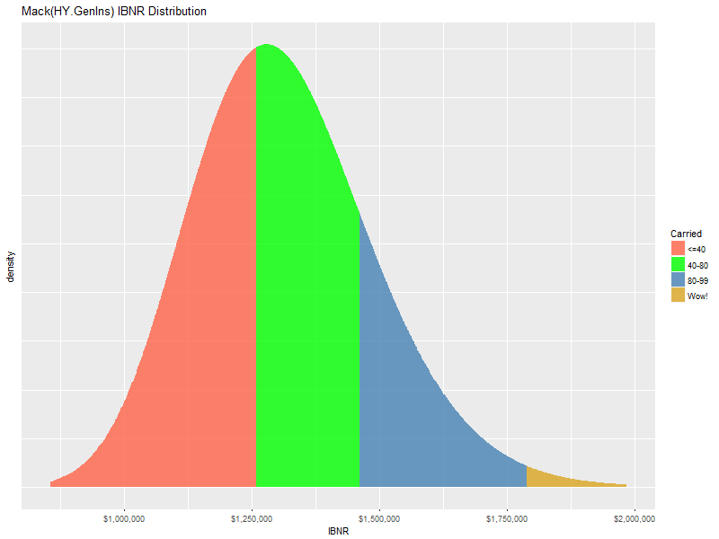
IBNR distributions from aggregated triangles have the same shape
Original GenIns
Aggregated triangle from Hai data

Slide 35
GenIns at the Claim Level: Claim detail sample in triangle format
Why the IBNR drop? Why the CV drop?
* simulated claims by Hai You

Slide 36
Is the weighted average development factor appropriate?
What happened to the 12-24 factor from the claim detail?!?

Slide 37
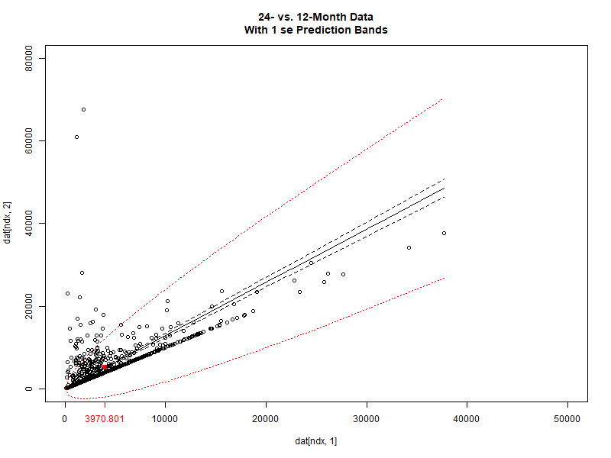
The 12-24 month relationship from the claim detail
What Chain-Ladder assumptions are violated in this data?

Slide 38
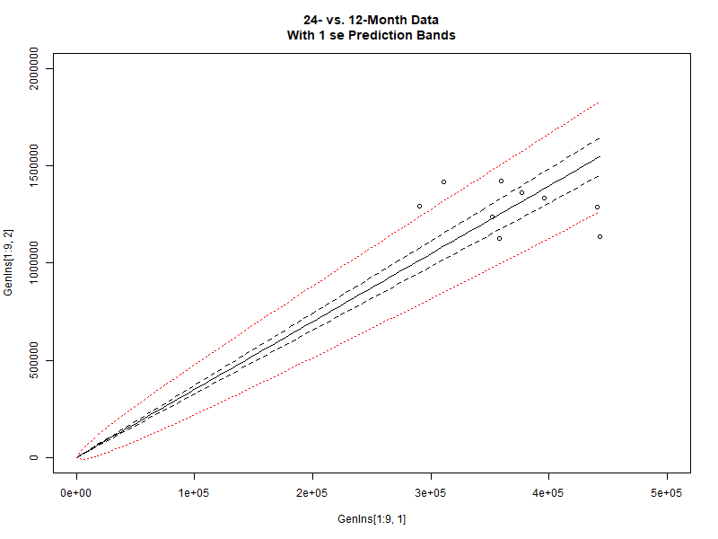
The 12-24 month relationship from the GenIns triangle
Is that the line you would draw through that data?

Slide 39
What’s next?
How to model serial correlation?
ARMA
Michael Wacek, “The Path of the Ultimate Loss Ratio Estimate”, eForum
Growth curves
Sherman; Clark; Guszcza
Bayes
Wüthrich
Individual Claim Development with Machine Learning (2017)
Neural Networks Applied to Chain-Ladder Reserving (2018)
Notes:
Rachel Boles, partial loss ratio
Guszcza, James. 2008. “Hierarchical Growth Curve Models for Loss Reserving.” In, 146–73. CAS Fall Forum; https://www.casact.org/pubs/forum/08fforum/7Guszcza.pdf

Slide 40
Can InsureTech jump the curve?
* graphics by Kirsten Singer
Notes:
Graphics by Kirsten Singer

Slide 41
Summary
Despite all its problems, the Chain-Ladder Mack/Murphy model is useful
The regression story of development is easy to tell and understood by today’s decision-makers who must take action based on what the story says
Everybody likes a picture!
Exciting actuarial analysis in the future will be in the predictive modeling (aka, data analysis) of the tail “down in the weeds”
Stories/models with clarity sell best

Slide 42
Q&A
Thanks for listening!
Dan Murphy
dmurphy@trinostics.com

